Slide 1
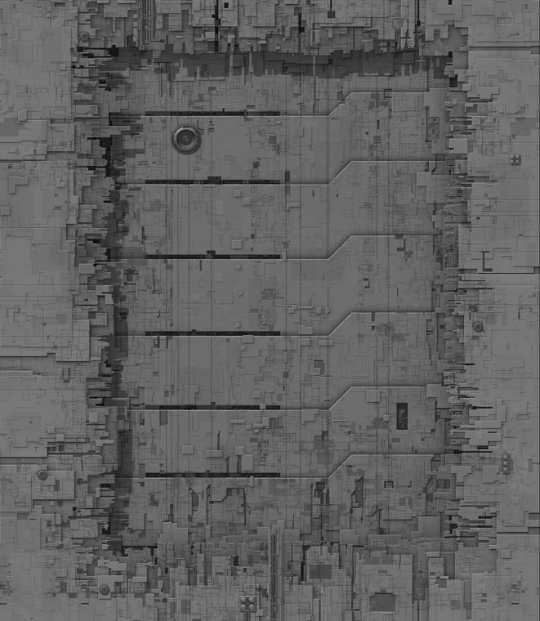


Genesis: Simulation Configuration Management
Douglas Swanson

Slide 2
Agenda
Background
Other Systems
Design
Demo
Summary

Slide 3
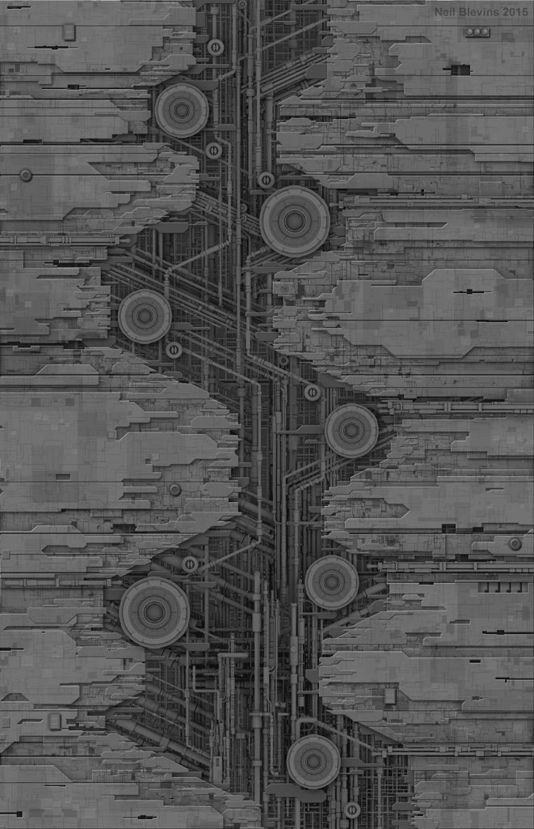
Introduction
The Genesis Scenario Configuration Management framework is the first step in designing a tool to manage the ever growing configuration demand of the Space Simulation Environment at the Boeing Company.
3

Slide 4





Background
Customer
Space Team
Virtual Warfare Center (VWC)
Boeing Phantomworks
Environment
Space Simulation
Problem
Configuring the Space Simulation Environment

Slide 5

Other Configuration Management Systems
Git
Current Space Sim Config
Widely know Software Version Control System
Works well with software development file systems
Called the Scenario Master Spreadsheet
Built in Excel
Cumbersome and error prone

Slide 6
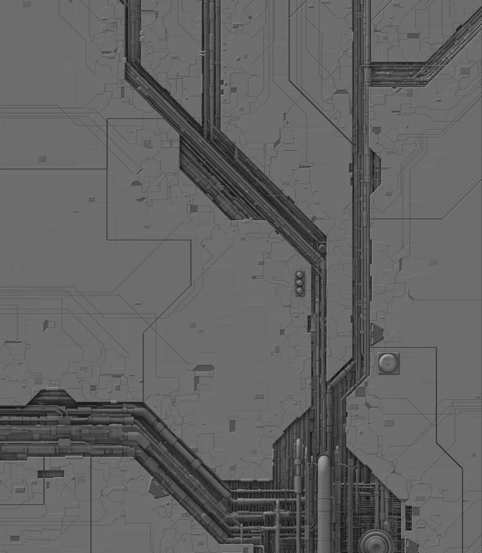

Design

Slide 7
Objectives
Should be Designed and Built with modules in mind
Should be able to run on any machine in the network
Should be accessible from any other machine in the network
Built with growth and modification in mind

Slide 8
Service Oriented Architecture
Databases
Services
Service Broker
Front End
Where the system’s data is stored
Does something useful for a consumer
Usually handles a single aspect of the system logic
Keeps track of all of the services running
Knows where they are and what their status is
Provides user access to the system
Validates and directs data

Slide 9

Databases
MySql Database
Relational
Main Data Storage
Template Database
Flat File Directory
Stores Complex Subsystem Configuration Models
Redis Database
Non-Relational Key-Value Store
Service Broker Storage

Slide 10

Services
CRUD
RESTful
Create
Read
Update
Destroy
Use HTTP methods explicitly
Be Stateless
Expose directory structure-like URI’s
Exclusively use JSON
Scenario Service
MySql Database
Template Database
Spacecraft Service

Slide 11

Service Broker
Register with the address of the machine they are running on
Clients of the broker can request the address of the services they are interested in
Scenario Service
Redis Service Broker
Spacecraft Service
Front End Server

Slide 12

Front End
Services
Redis Service Broker
User Interface
Template Database
Front End Server
Front End Server
User Interface
Serves React App
Allows App Access to Template Database
Connects App to service Broker
Takes in User Responses
Makes Requests of the Services
Displays Current State of Scenario Data

Slide 13
Design Diagram
User Interface
Spacecraft Service
MySql Database
Scenario Service
Front End Server
Template Database
Redis Service Broker

Slide 14

Demo

Slide 15
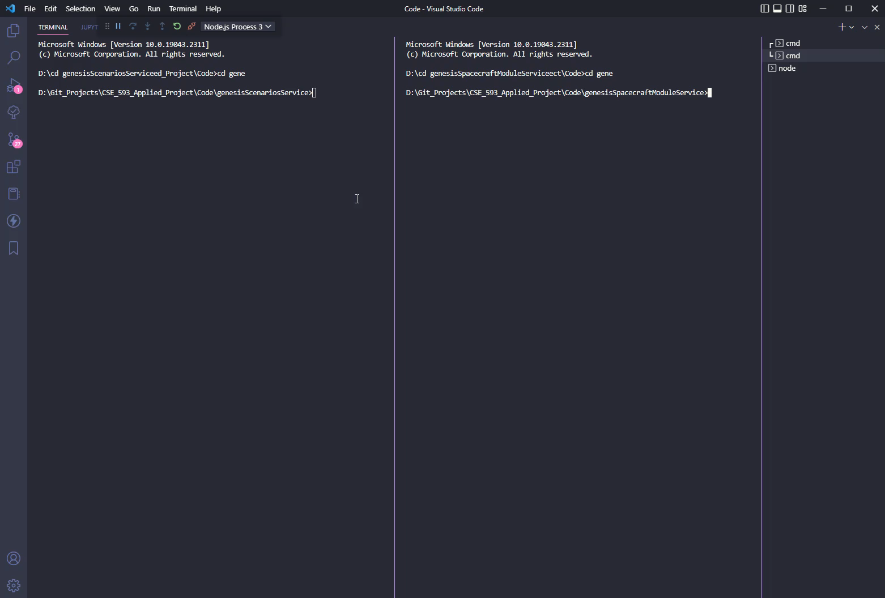
Starting the Services

Slide 16
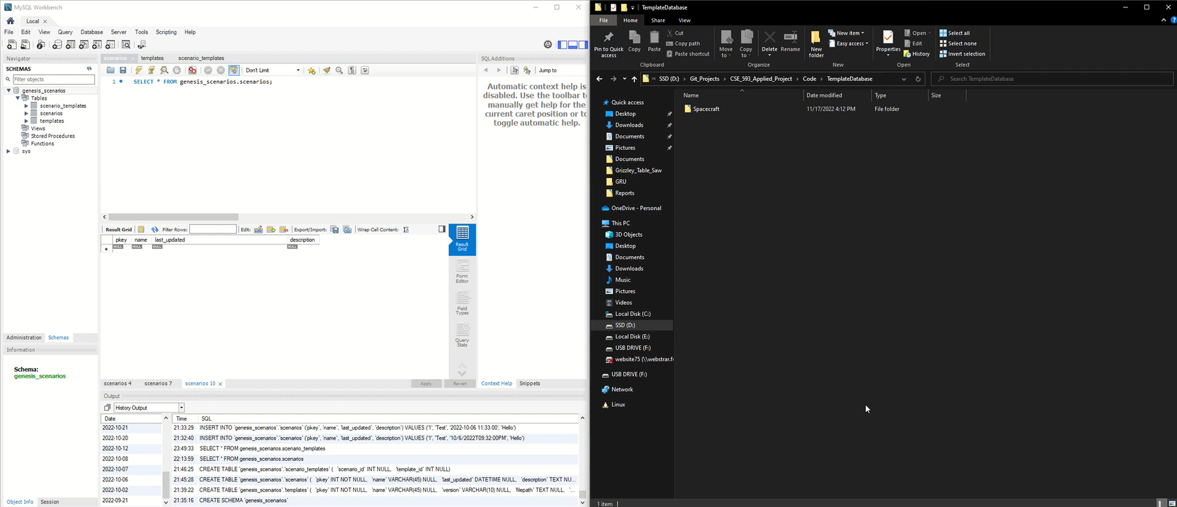
Exploring the Databases

Slide 17
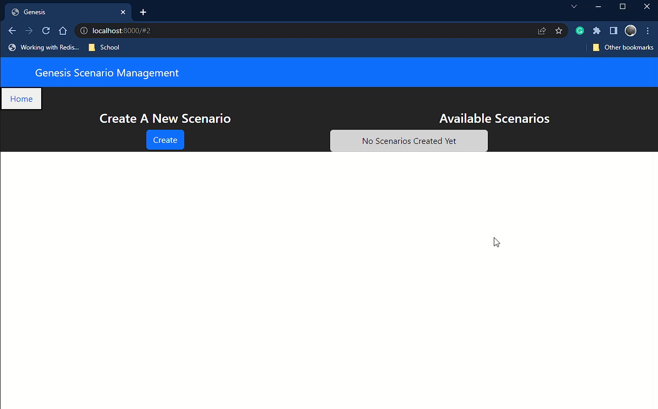
Creating a Scenario

Slide 18
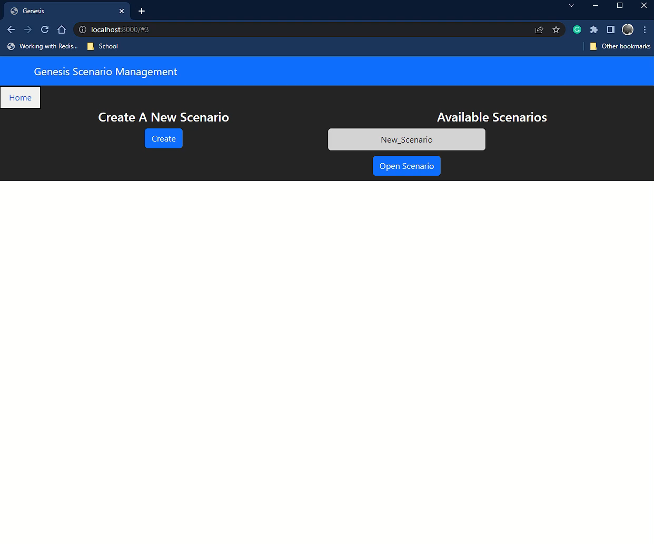
Editing Scenario Data

Slide 19

Summary
Background
Other Systems
Design
Demo
19

Slide 20




Thank you

Slide 21
Sources
(Boeing Logo) Provided by the Boeing Company
(Spacecraft Hull Designs) By Neil Blevins https://www.artstation.com/artofsoulburn
(Phantomworks Logo) Provided by the Boeing Company
(Git Logo) https://git-scm.com/images/logos/downloads/Git-Icon-1788C.svg

